Slide 1
Introduction to LLVM (II)
Bojian Zheng
CSCD70 Spring 2018
bojian@cs.toronto.edu

Slide 2
Makefile Error: Optimize.mk
In the Optimize.mk file provided in the first assignment, you might need to add ./ in front of the optimizer target FunctionInfo.so.
Thanks a lot to Chengyu (Tyrone) Xiong for pointing this out.

Slide 3
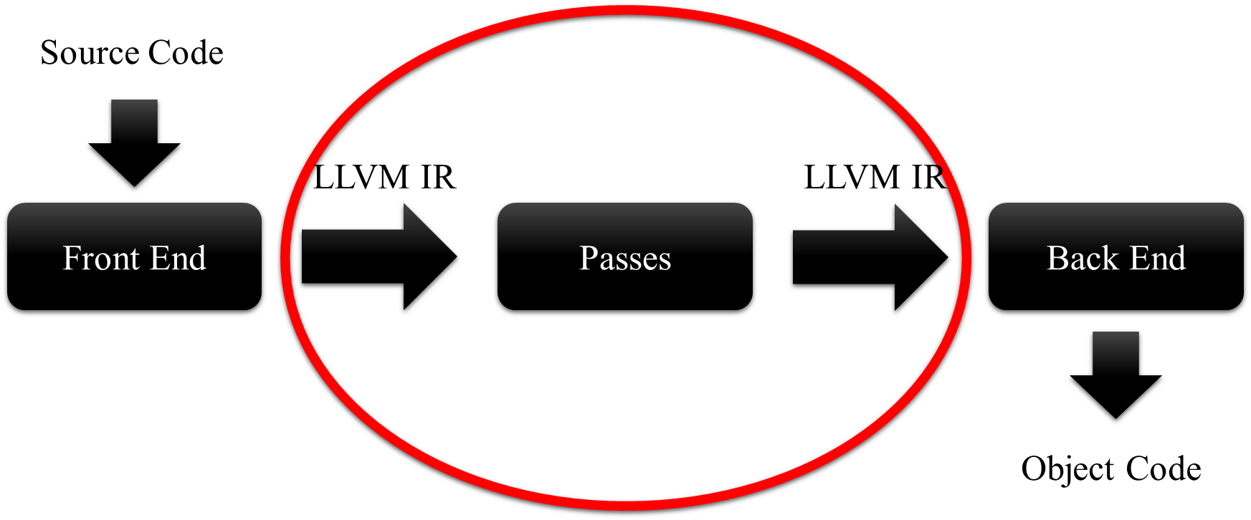
Review
Keywords:
  Intermediate Representation (IR)
  Optimization Pass
  Analysis & Transformation

Slide 4
Review
Keywords:
  Program Structure
  Iterators
  Downcasting
  LLVM Pass Interface

Slide 5
Transformations

Slide 6
Insert/Remove/Move/Replace Instructions
Three Options
  Instruction class methods.
  Ask parent (BasicBlock) to do this.
  Make use of BasicBlockUtils.

Slide 7

Attention! Iterator Hazard
As you do transformations, iterators might be invalidated.
  $→$ Demo on std::vector < unsigned > ::iterator
Thanks a lot to Qiongsi Wu for bringing this up.

Slide 8
Attention! Reference Updates
Original Code
Transformed Code
%2 = add %1, 0
%3 = mul %2, 2
%2 = add %1, 0
%3 = mul ???, 2

Slide 9
Questions?
Keywords:
  Iterator Hazard
  References Update (More Later On)

Slide 10
LLVM Instruction: The
User-Use-Usee Design Pattern

Slide 11
LLVM Class Hierarchies
Value
User
Instruction

Slide 12
Value (Usee)
The Value class is the most important base class in LLVM.
  It has a type (integer, floating point, …): getType()
  It might or might not have a name: hasName(), getName()
  Keeps track of a list of Users that are using this Value.

Slide 13
Instruction (User)
An User keeps track of a list of Values that it is using as Operands:
  User user = …
  for (auto iter = user.op_begin();
  iter != user.op_end(); ++iter)
  {Value * operand = *iter; …}
An Instruction is a User.

Slide 14
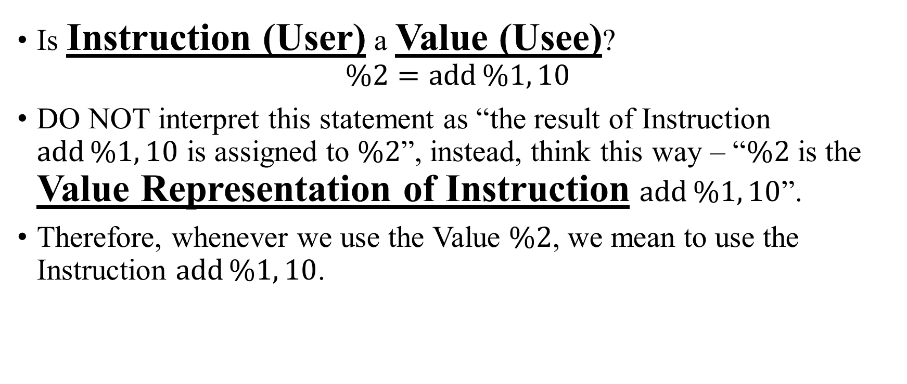
But wait, …
Is Instruction (User) a Value (Usee)?
$$\%2=\operatorname{add}{\%1, 10}$$
DO NOT interpret this statement as “the result of Instruction $\operatorname{add}{\%1, 10}$ is assigned to $\%2$”, instead, think this way – “$\%2$ is the Value Representation of Instruction $\operatorname{add}{\%1, 10}$”.
Therefore, whenever we use the Value $\%2$, we mean to use the Instruction $\operatorname{add}{\%1, 10}$.

Slide 15
To Conclude
Suppose we have an instruction: Instruction inst = …
  What is this instruction using?
  for (auto iter = inst.op_begin();
  iter != inst.op_end(); ++iter)
  {…}
  What is using this instruction?
  for (auto iter = inst.user_begin();
  iter != inst.user_end(); ++iter)
  {…}

Slide 16
Questions?
Keywords:
  User-Use-Usee Design Pattern

Slide 17
Optimizer Manager

Slide 18
Optimizer Manager
What is this doing?
  void Analysis::getAnalysisUsage(AnalysisUsage & AU) const
  {
  AU.setPreservesAll();
  }
Very frequently, when writing a pass, we want the followings:
  What information does this pass require?
  Will this information still be preserved after this pass?

Slide 19
Questions
Keywords:
  Require
  Preserve

Slide 20
Code Download Links
https://github.com/ArmageddonKnight/CSCD70-Tutorial-Demo
Visitor Design Pattern
  serves as an alternative to Dynamic Casting.
  You can find an example on this in the repository.

